Slide 1
I choose this project because I thought it would be fun to look at and well, I like wine. ☺ I wanted to see if there was a way to code red and white wines that have been graded for quality and see if we can write a code to predict quality based on that. My reasoning behind it was to see if walking the aisles aimlessly was a thing of the past and could we simply see if certain a certain ingredient or ingredients have an effect on the quality of wine. That way if you were to look at the ingredients you could tell if it would be a high quality or not.

Slide 2
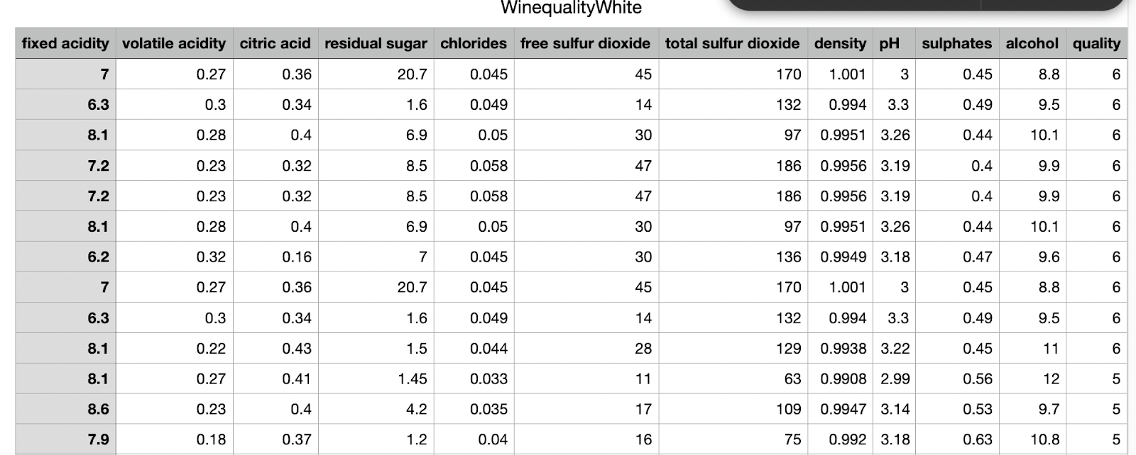
Here is a snapshot of the White Wine dataset I will be using .

Slide 3
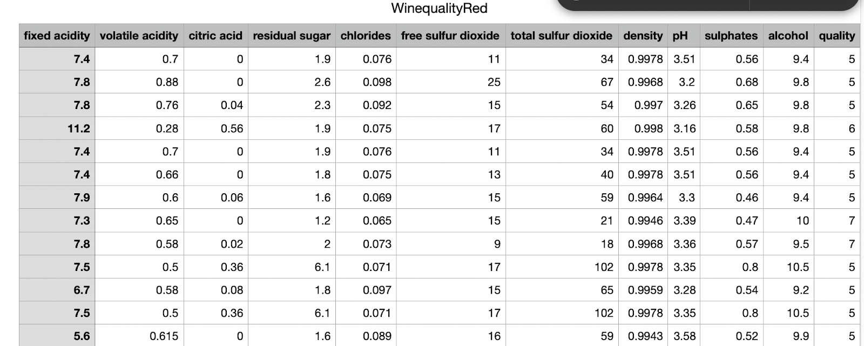
Here is a screenshot of the Red Wine dataset.
Trying to find a dataset was difficult. Some sets were not clean or had way to many categories to clean . This one that I found was set up nice and had what I was looking for in an easy to read/follow format .

Slide 4

As you can see there are 12 columns for the different ingredients in wine.

Slide 5
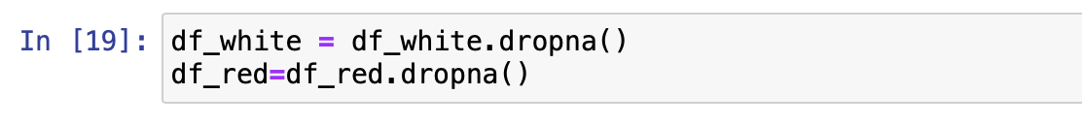
Before I can start coding using the data I need to make sure all missing values or null values are dropped so that it is as clean as it can be moving forward

Slide 6
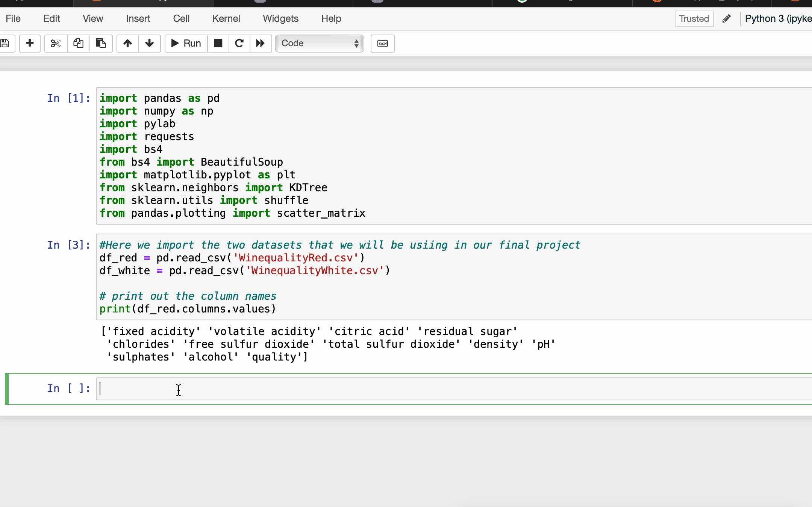
As you see here the data sets are not equal in size , so we need to lower the white wine data to match the red

Slide 7
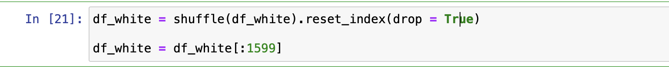
Because we do not want to be biased, we need to shuffle the data and make it equal to the red white data amount

Slide 8
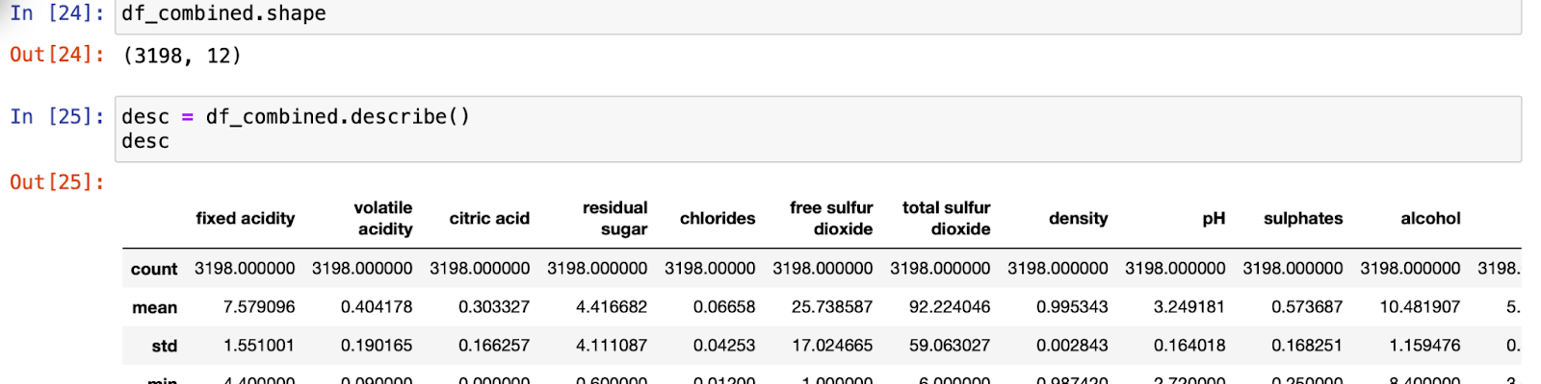
Before I can move on I needed to make sure the dataset for white and red wine was combined so that I can work with one dataset moving forward.

Slide 9
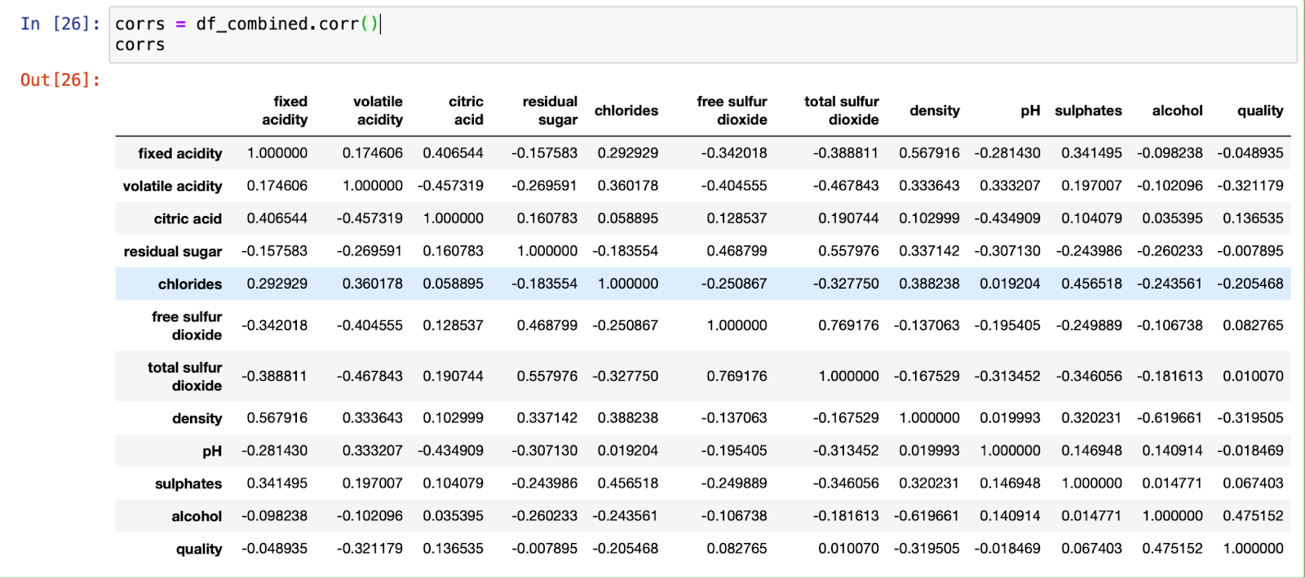
Here I wanted to see if there was any direct correlation to an individual ingredient to quality.

Slide 10
Since there was no direct correlation between an ingredient or ingredients to quality using the combined dataset, it was time to see if one specific ingredient had a correlation to quality. So I decided to plot each one against quality to visually see.

Slide 11
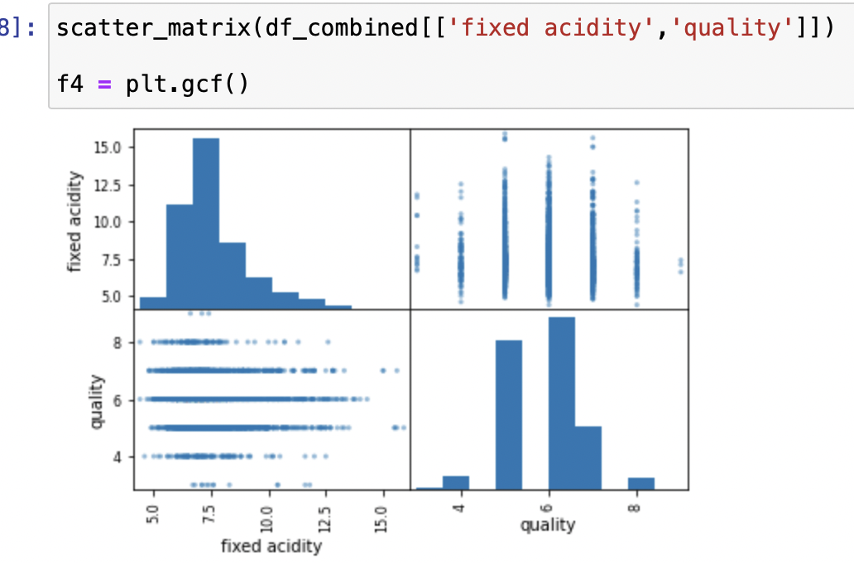
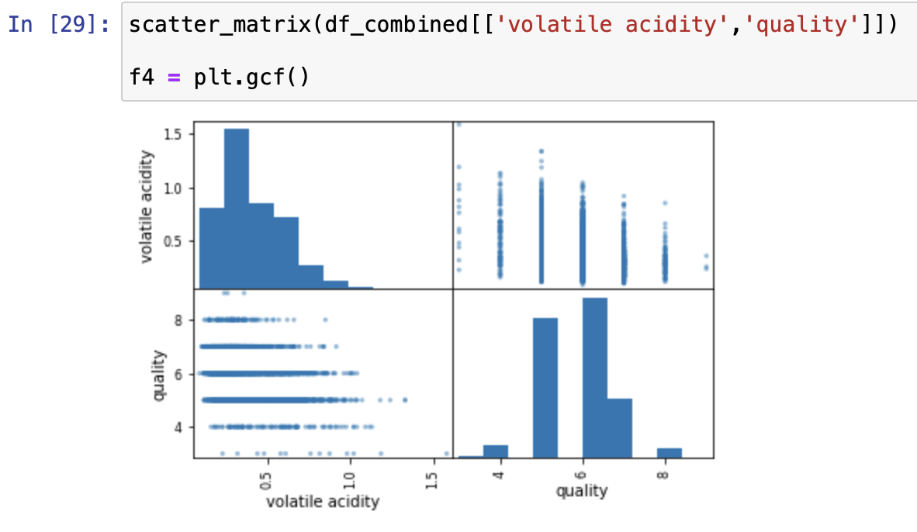
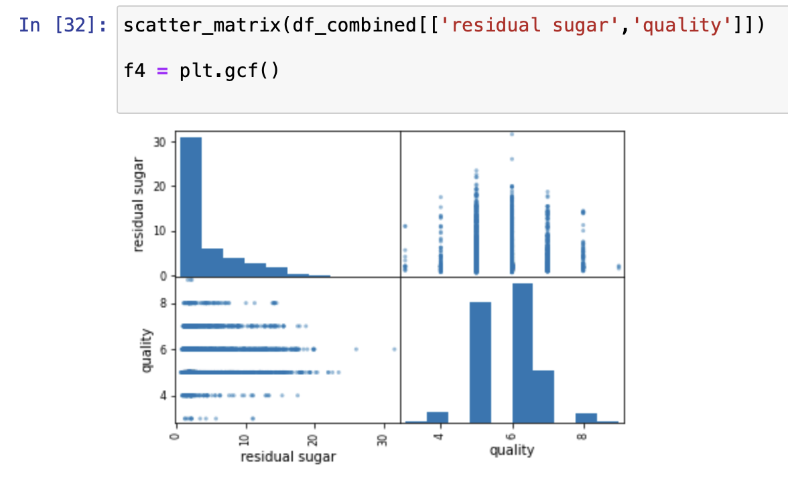
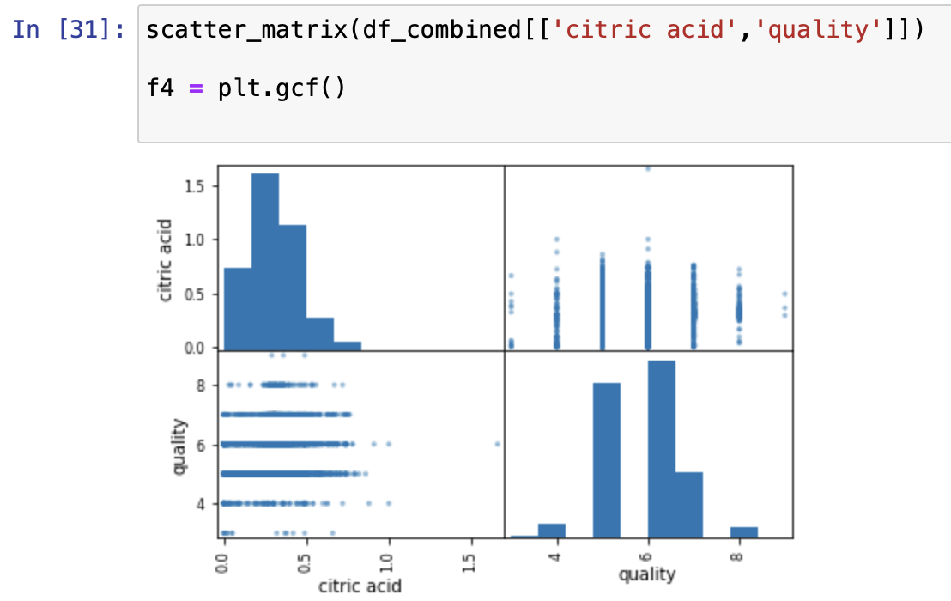
Here are my visuals

Slide 12
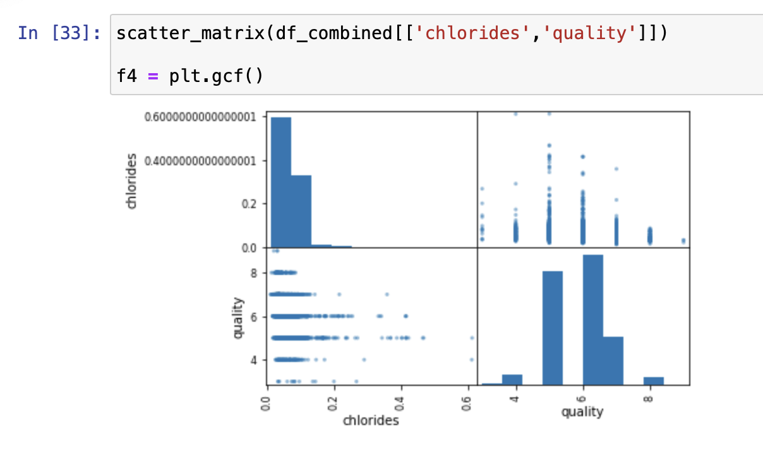
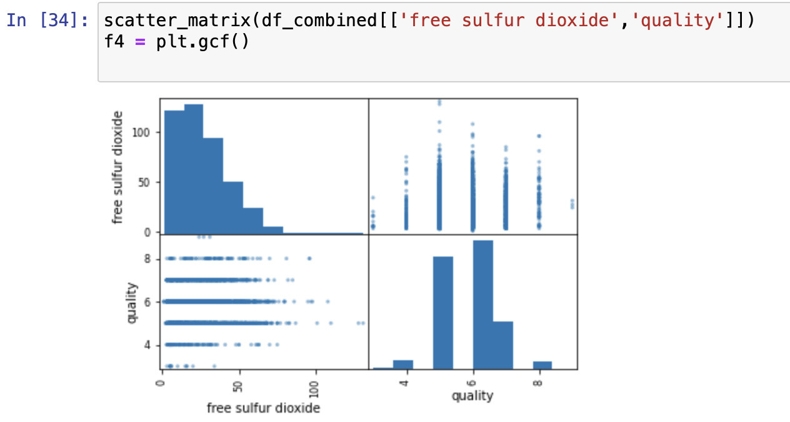
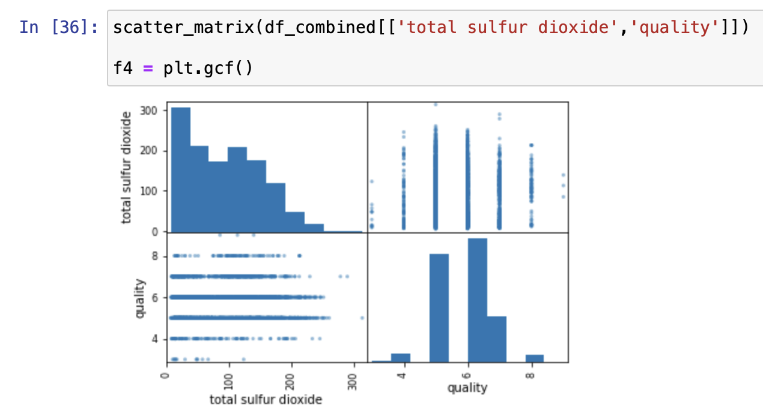
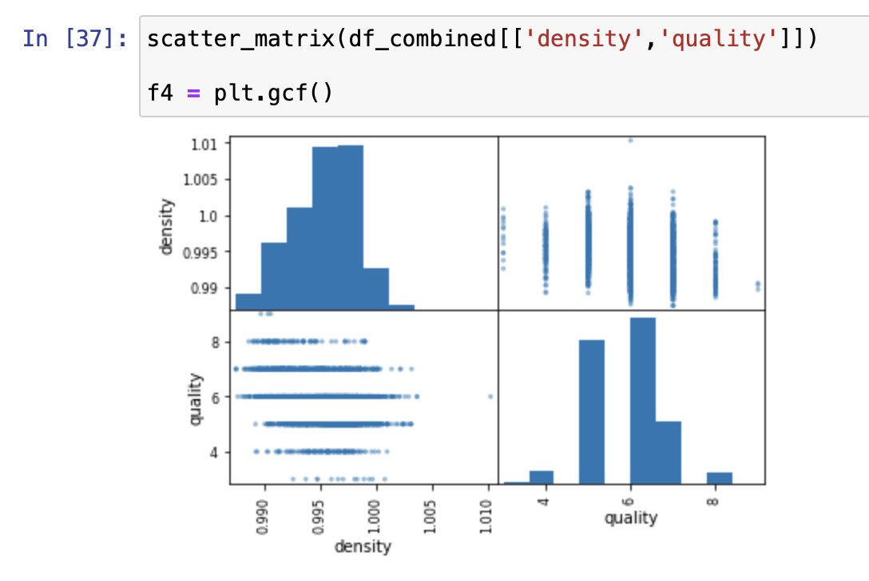

Slide 13
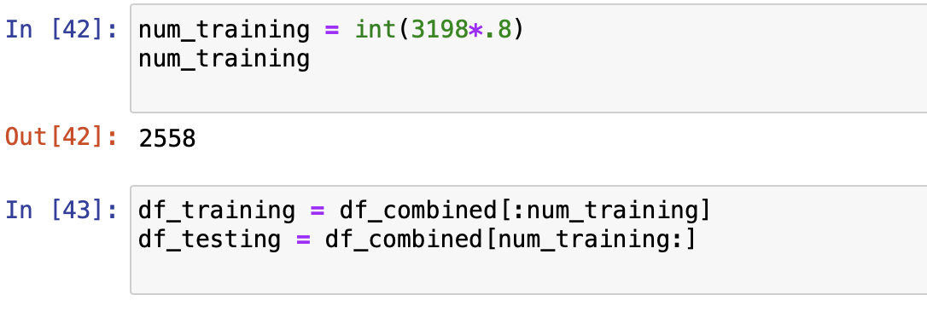
To dive further into the data I created a training and testing dataset.
The training set will be 80 percent of the data and the testing 20 percent
Now that I combined the data and looked at the plot maps and correlation it's time to dive deeper and see if we can predict wine quality. So I decided to use a KD tree to store the wine data but I need to determine what k value is best to use.

Slide 14
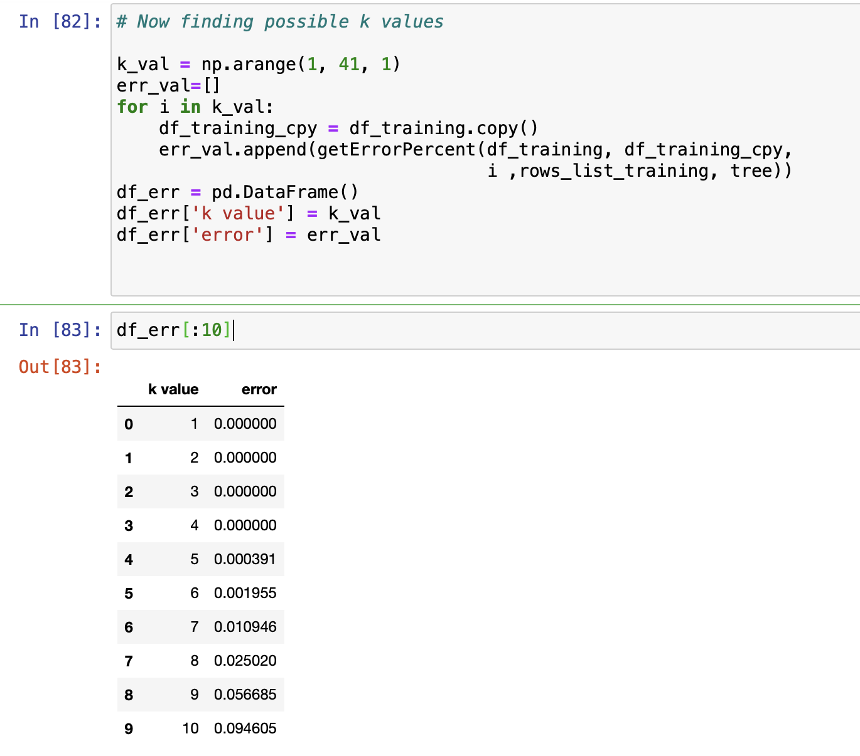
After making a training and testing data set at 80% and 20% I The training set showed me what the quality was if we ignored the wine .
I then went on to see if we can return the predicted wine quality and wanted to use a K-D tree to do so. But first I needed to find what K value to use.

Slide 15
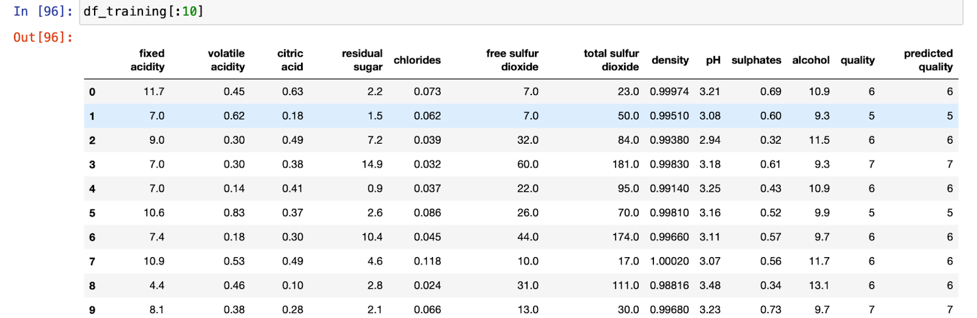
My training dataset which ignored the type of wine gave the predicted quality equal to what the dataset quality was showing

Slide 16
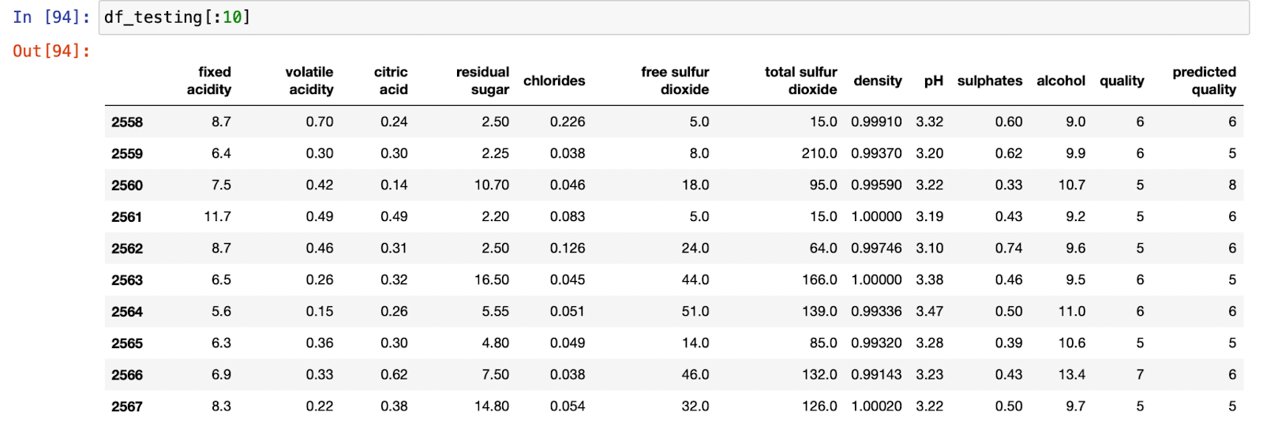
The testing dataset however was not so clean , but it was close. Our predicted wine quality was either off by one or equal.

Slide 17
Conclusion

